Slide 1




SaveMed
CMPS342
Mohammad Al Sharif
Omar ghazzawi
Hassan Atwi
Instructor:Dr.Lama Affara
SaveMed

Slide 2
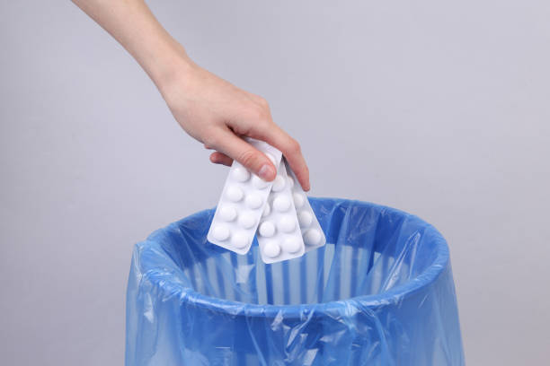
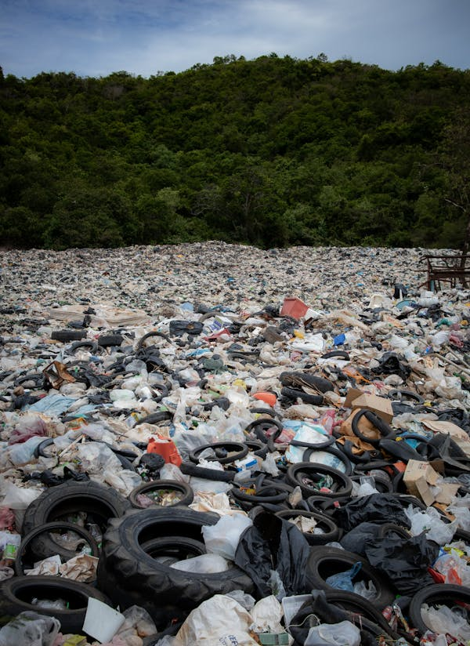
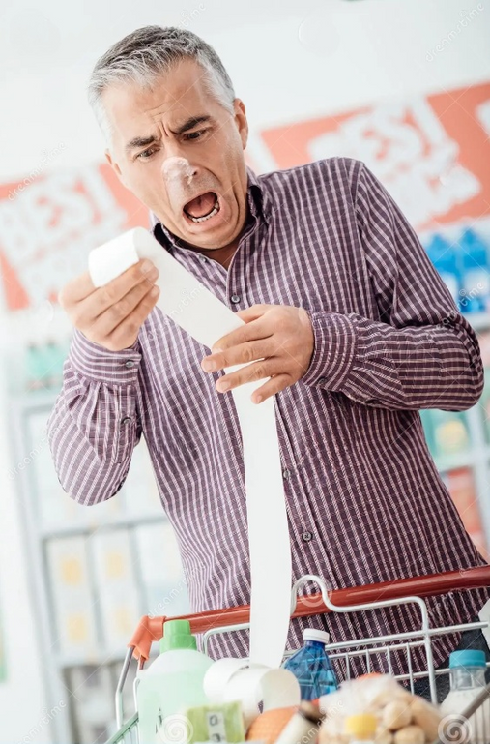
$2.8 billion dollars of medications are being wasted every single year

Slide 3
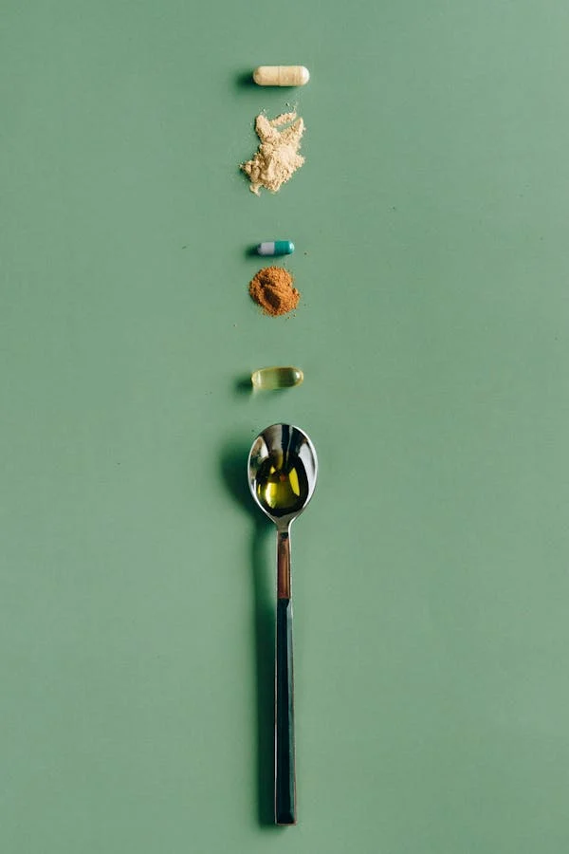
Topic Motivation
Waste Reduction
Healthcare Affordability
Public Health Impact
Financial Support

Slide 4

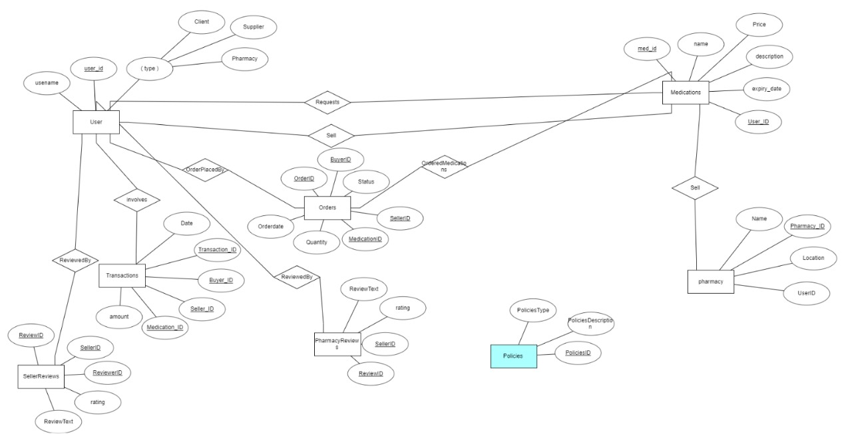

ER Diagram

Slide 5
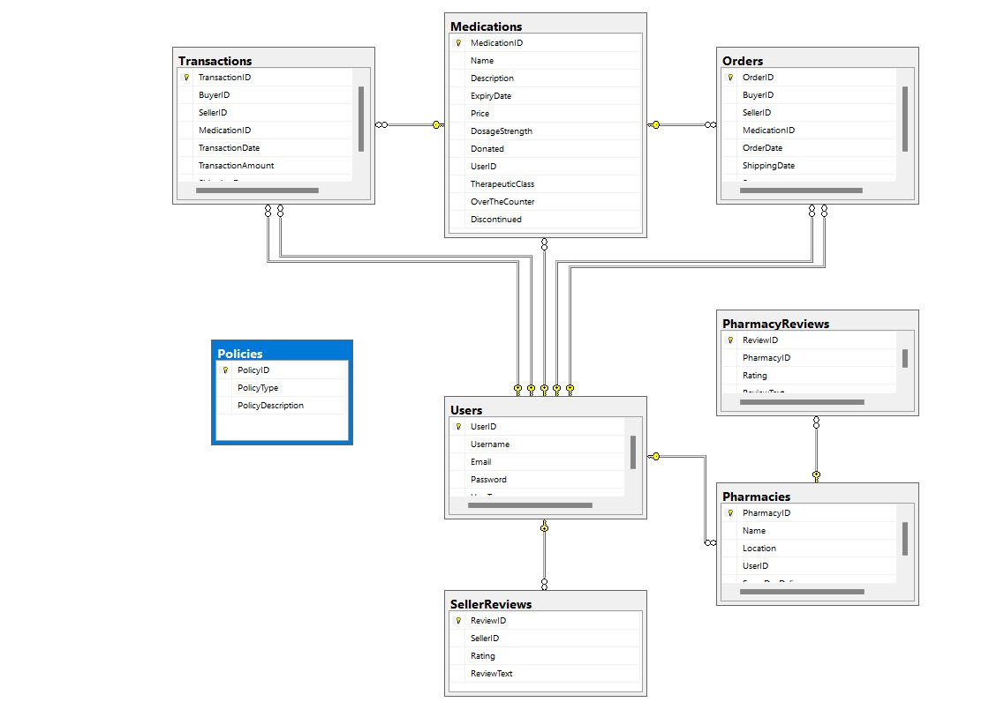
UML Diagram

Slide 6
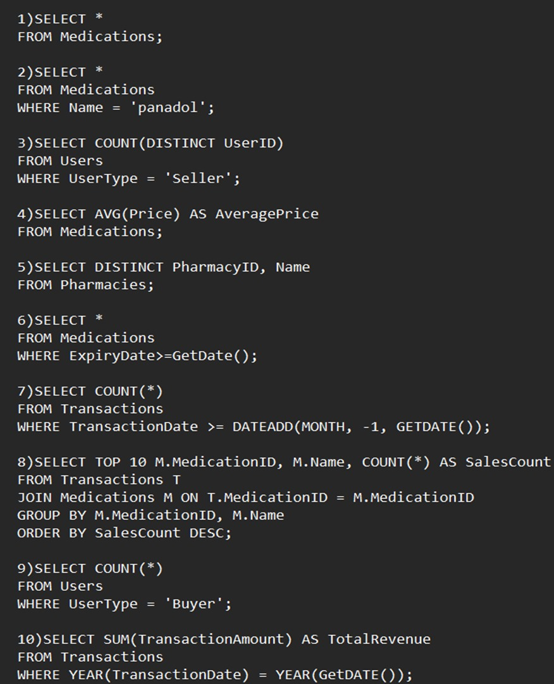
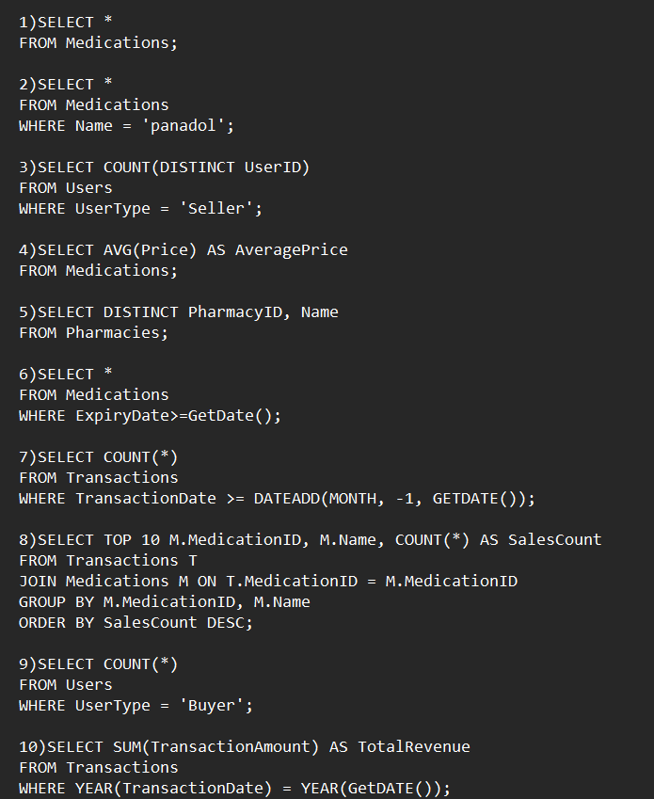
TOP QUESTIONS
1. What are the available medications listed for sale on SaveMed?
2. Can I search for medications by their brand name?
3. How many sellers are currently active on SaveMed?
4. What is the average price of medications listed by sellers?
5. Which pharmacies have listed their products on SaveMed?
6. Can I search for medications based on their expiry date?
7. How many medications have been sold in the past month?
8. What are the top-selling medications on SaveMed?
9. How many users are registered as buyers on SaveMed?
10. What is the total revenue generated from medication sales this year?

Slide 7
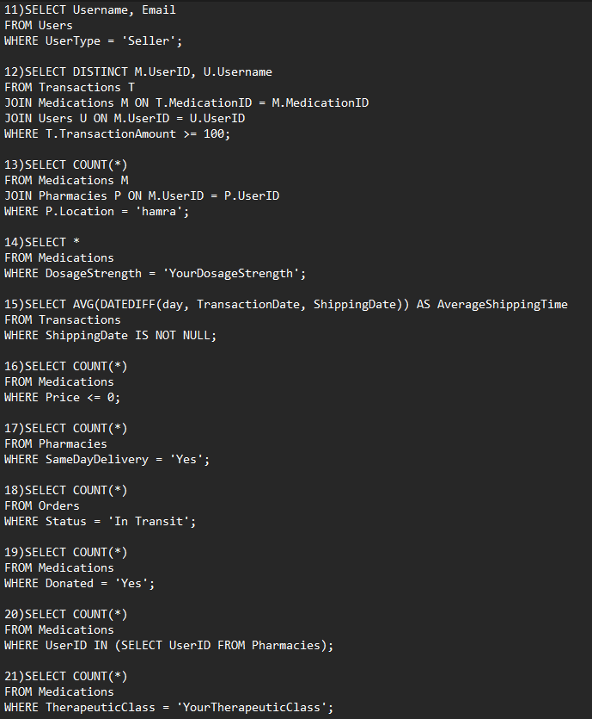
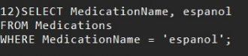
TOP QUESTIONS
11. Can I view the contact information of sellers?
12. Is Espanol available?
13. How many medications are currently available for purchase in my area?
14. Can I filter medications based on their dosage strength?
15. What is the average shipping time for medications purchased on SaveMed?
16. Are there any medications available for free or at a reduced price for low-
income individuals?
17. How many pharmacies offer same-day delivery for medications?
18. Can I track the status of my medication order?
19. How many medications have been donated by users on SaveMed?
20. What is the total number of medications listed by pharmacies?
21. Can I search for medications based on their therapeutic class?

Slide 8
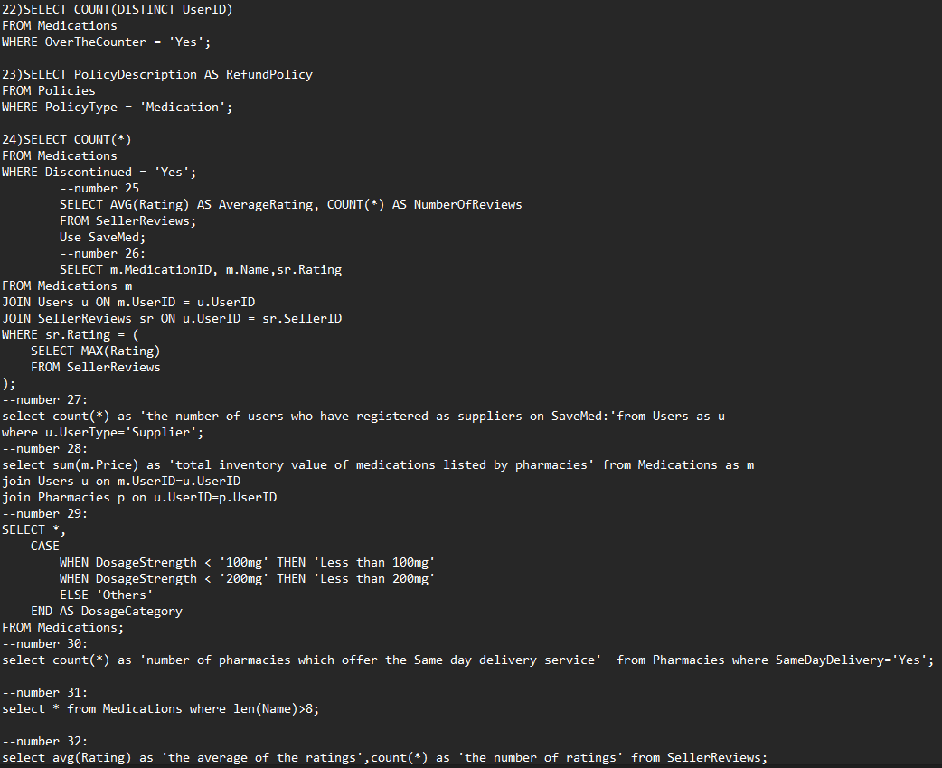
TOP QUESTIONS
22. How many sellers offer over-the-counter medications?
23. What is the refund policy for medications purchased on SaveMed?
24. How many medications have been discontinued by sellers?
25. Can I view the ratings and reviews of sellers and pharmacies?
26- What are the top-rated medications based on supplier reviews?
27- How many users have registered as suppliers on SaveMed?
28- What is the total inventory value of medications listed by pharmacies?
29- Can I filter medications based on their dosage strength?
30- How many pharmacies offer same-day delivery service?
31- Display medications who’s their names each consist of more than 8 letters.
32- Find the average rating and number of reviews for sellers.
33- What is the average shipping cost for medications listed for sellers?

Slide 9
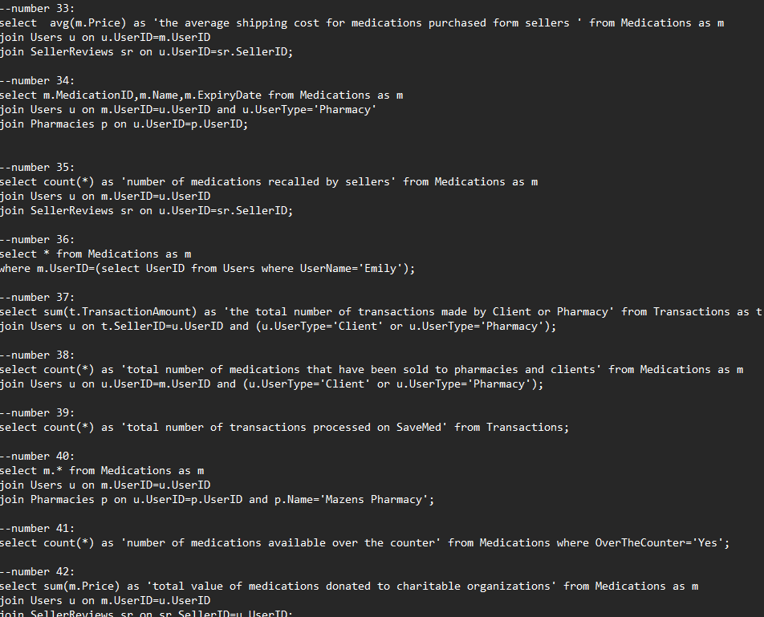
TOP QUESTIONS
34- Can view the expiration dates of medications listed for sale?
35- How many medications have been recalled by sellers?
36- List all medications sold by a specific seller.
37- Find the total number of transactions made by each client and pharmacies.
38- How many medications have been sold to pharmacies and clients?
39- What is the total number of transactions processed on SaveMed?
40- List the medications available at a specific pharmacy.
41- Count the number of medications available over the counter.
42- What is the total value of medications donated to Suppliers?
43- Find the highest-rated pharmacy based on user reviews?
44- Retrieve Policy types and their descriptions.
45- List the average of prices of all medication offering same-day delivery.
46- Display the total number of transactions for each pharmacy located in ‘456 Elm St’.
47- List medications that haven’t received any reviews from suppliers yet.

Slide 10
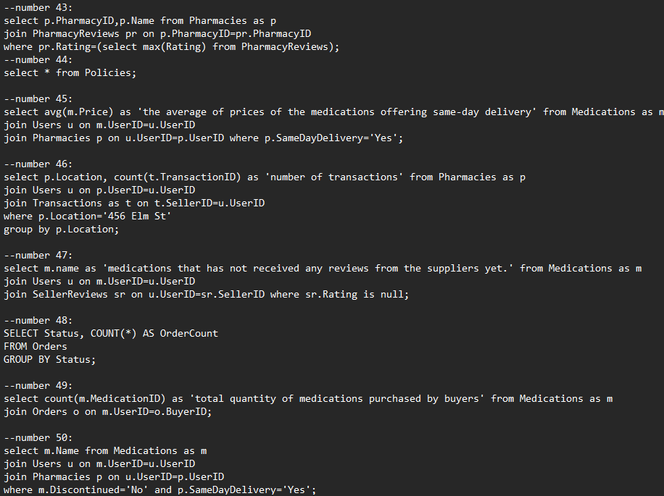
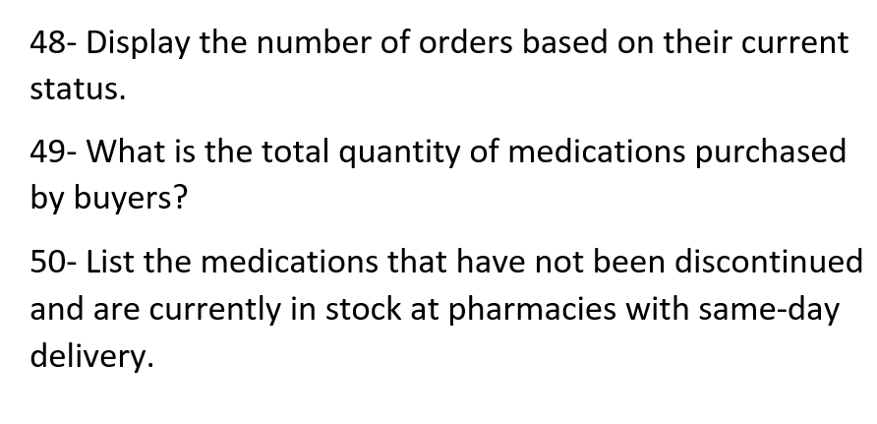
TOP QUESTIONS

Slide 11
TOP QUESTIONS
51- How many medications are available with insurance coverage?
52- Can I search for medications based on their side effects?
53- Can we increase the prices of all the medications by 10%?
54- Can we increase the prices of the medications that have insurance coverage by 15%?
55- Can we retrieve data from the Medications table in descending order of prices?
56- Can we retrieve data from the Medications table in ascending order of prices?
57- Can we find the total transaction amount for each medication?
58- Can we find the medication having the least price?
59- Can we find the medication having the highest price?
60- Can we find the medications with an average price greater than 15$?
61- Can we retrieve medications at specific ids?
62- Can we retrieve all medications and their associated users, including medications who don't have any users listed?
63- Can retrieve all users and their associated medications, including users who don't have any medications listed?
64- Can we decrease the prices of the medications to half (the ones that are related to the suppliers)?
65- can we delete the table Policies.

Slide 12
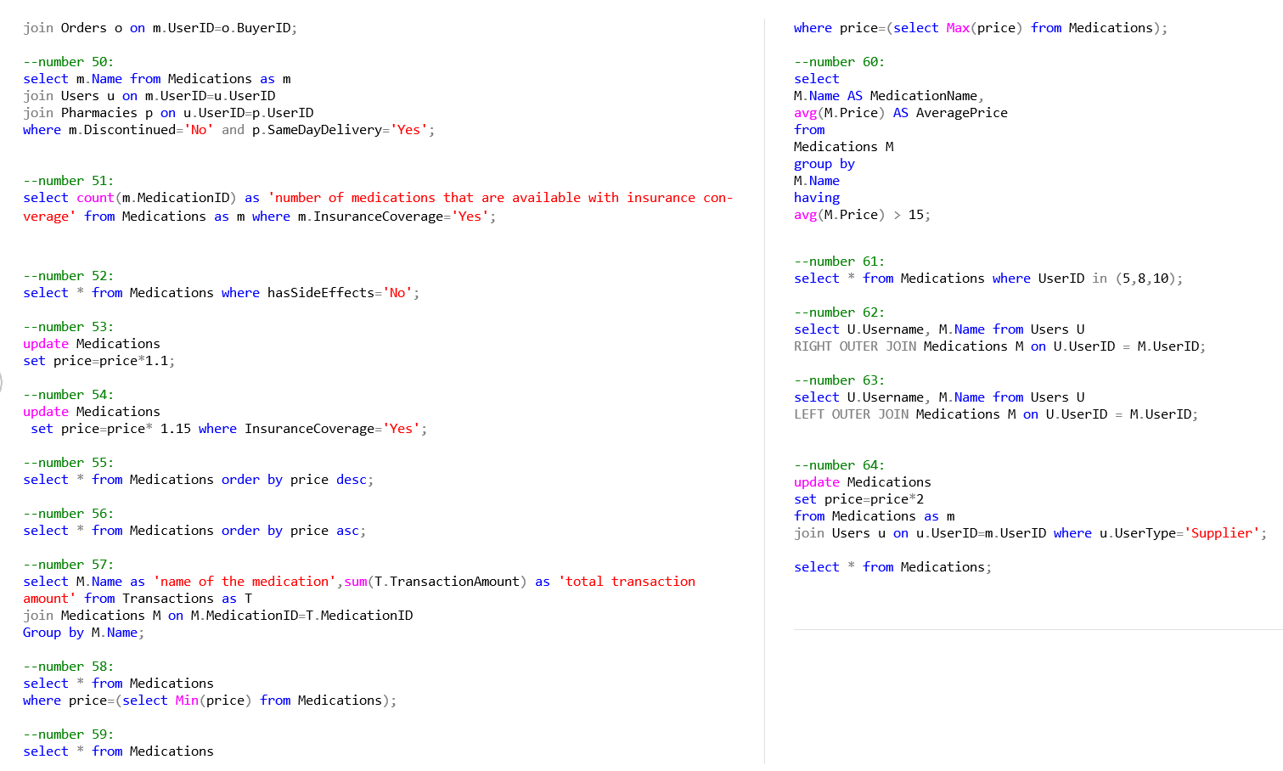
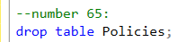

Slide 13

Challenges faced
The DataBase of the Users
and medications is so big
SQl Injection
Data Integrity: Ensuring that the data entered into the database is accurate and consistent can be challenging, especially when dealing with multiple tables and complex relationships.
Query Optimization: Writing efficient SQL queries that retrieve the required data without unnecessary overhead can be challenging, especially as the database grows in size.

Slide 14
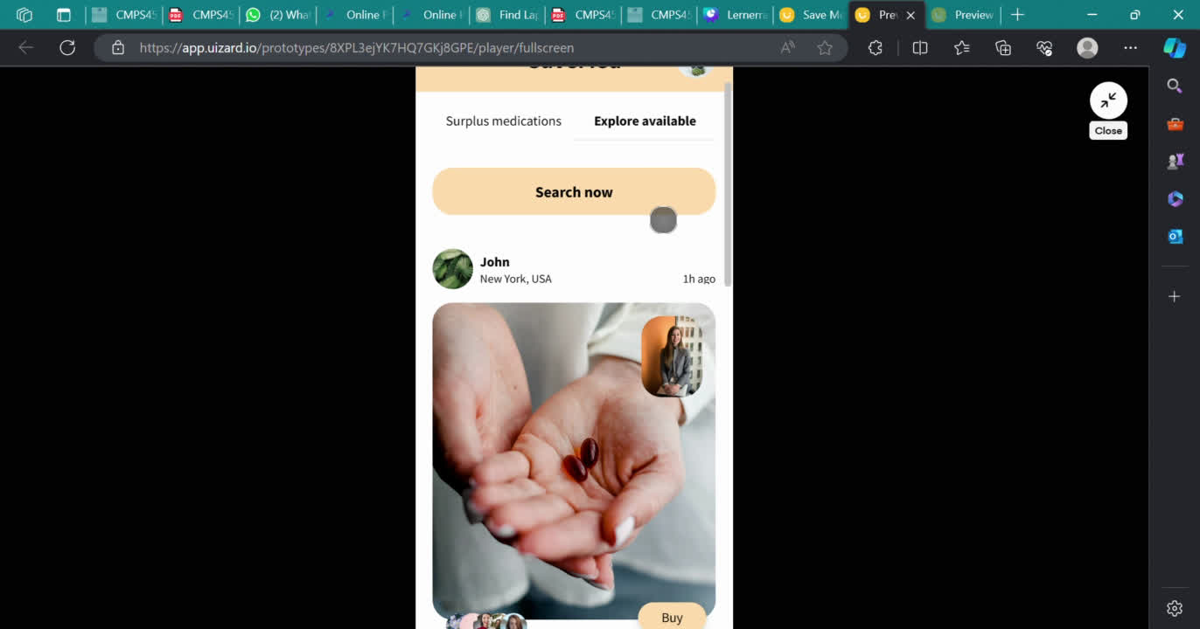
App UI

Slide 15
Mohammad
Omar
Hassan
Team Collaboration
40 queries
Erd
powerpoint
report of the project
UML DIAGRAM
Creating the database of the project(tables)
25 queries

Slide 16

THANK YOU

